Slide 1
Nest Labs
Innovation for Energy and the Environment
Mario Avila, Jeffrey Quackenbush, Carlos Saborio Villalta, and
Christopher Yoder

Slide 2
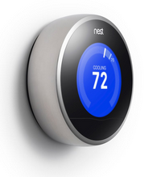
Executive Summary
Nest Labs
Smart Thermostat
Revolutionizing the heating and cooling industry
42% of consumer home energy expenditures attributed to heating and cooling (EIA) or roughly $1,000 a year
Large thermostat market and an even larger home appliances market
Savings of $201 per year

Slide 3
Introduction
1st and 2nd generation Nest learning thermostats
Constant connection via a smart phone, tablet, and Internet
Sold at Lowe’s, Best Buy, Amazon, and the Apple Store
130 employees
Based in Palo Alto, CA
Kleiner Perkins, Google Ventures, and 5 other well established venture capitals

Slide 4
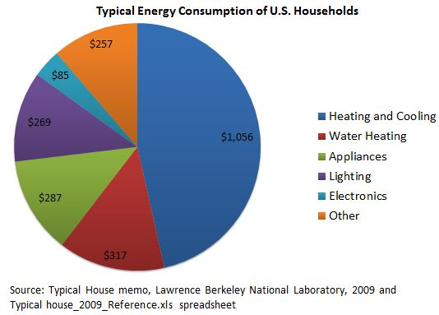
Current and Future Demand/Market

Slide 5
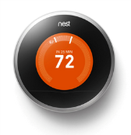
Nest Learning Thermostat
The results of a October 2012 report found that homeowners using Nest’s Auto-Schedule and Auto-Away features saved 20.1%.⁴
Works with 95 percent of all 24V systems including gas, electric, forced air, heat pump, radiant, hot water, solar, and geothermal

Slide 6

Rich Patent Portfolio
User Friendly Interface for Control Unit - US 2012/0203379 A1
Thermostat Graphical User Interface - US 2012/0131504 A1
Thermostat User Interface - US 8,195,313 B1
Thermostat With Self-Configuring Connections to Facilitate Do-It-Yourself Installation - US 2012/0248211 A1
System Methods for Updating Climate Control Algorithms – Under Review
Adaptive Power Stealing Thermostat – Under Review

Slide 7






Leadership
Tony
Chip
Matt
Yoky
Erik
John

Slide 8
Market Demand
Customer Preferences For Smart Thermostats
Tugrul U. Daim, Ibrahim Iskin, (2010),"Smart thermostats: are we ready?", International Journal of Energy
Sector Management, Vol. 4 Iss: 2 pp. 146 - 151
Notes:
Given the obvious demand for energy savings and specifically smart thermostats, Nest will need to focus on how best to meet that rising customer demand. Studying customer preferences to determine how to invest research and development funds is critical for future success.
Tugrul U. Daim, Ibrahim Iskin, (2010),"Smart thermostats: are we ready?", International Journal of Energy
Sector Management, Vol. 4 Iss: 2 pp. 146 - 151

Slide 9





Thermostat Competition

Slide 10

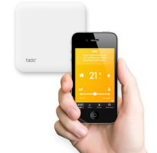

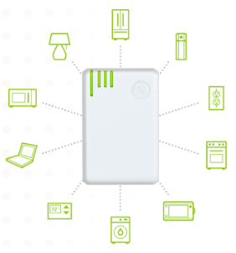
Other Competitors
Pulls information from smart meters and certain GE products
Doesn’t allow customers the ability to control units remotely only provides information
Tado is currently only sold in Germany
Free hardware but $126 annual subscription fee
Notes:
GE Nucleus Home Manager – Requires a smart meter to measure the energy consumption of the home – IEE (Institute for Electric Efficiency) estimates that 1/3 of residential homes currently have smart meters in a 2012 (http://www.edisonfoundation.net/iee/Documents/IEE_SmartMeterRollouts_0512.pdf)

Slide 11
Current and Future Demand/Market
91 million households have thermostats with 25 million smart thermostat.³
$200 X 66 million = $13.2 billion
91 million
25 million
Notes:
Given that the majority of a typical household’s energy bill (almost 50%) comes from heating and cooling the house, it makes sense to reduce the cost associated with that function. Although
http://www.energystar.gov/ia/partners/prod_development/revisions/downloads/thermostats/Summary.pdf

Slide 12
Economic Analysis

Slide 13
Economic Analysis

Slide 14
Economic Analysis
$181 Energy Savings
$20
1.1 Ton GHGs
$201 Total Savings
Notes:
Calculations base on EIA data from 2005:
Table SH9. “Average Expenditures for Space Heating by Main Space Heating Fuel Used, 2005 Dollars per Household.” Used natural gas figures. The average expenditure of natural gas for heating per U.S. household is $544 per year.
Table AC7. “Average Expenditures for Air-Conditioning by Equipment Type, 2005 Dollars per Household.” Used electricity figures. The average expenditure of electricity for cooling per U.S. household is $335 per year.
Table SH7. “Average Consumption for Space Heating by Main Space Heating Fuel Used, 2005 Physical Units per Household.” Used natural gas figures. The average U.S. household consumes 49,000 cubic feet of natural gas per year.
Table AC5. “Average Consumption for Air-Conditioning by Equipment Type, 2005 kWh per Household.” Used central A.C. systems figures. The average U.S. household consumes 3,475 kWh of electricity per year.

Slide 15
Learning and Diffusion
Notes:
Orange Line – Industry Sales Trend “Sales of programmable thermostats have doubles over the last 10 years.^{3”}
Green Line – Nest Sales Trend
Started selling October 2011 but had some supply chain issues and couldn’t meet initial demand
“Sold at least 10,000 by April 5th, 2012^{1”}
Since releasing the first Nest last October, sales have been “in the mid-hundreds of thousands” of units, according to the company by October 2012.²

Slide 16
Learning and Diffusion
Notes:
Blue Line – 91 million which is U.S. Market Saturation

Slide 17
Environmental Management Systems
Private Partnerships
Government Programs
Product Standards
Notes:
Product Standards:
Working with ENERGY STAR® on “Program Requirements for Residential Climate Controls - Partner Commitments” and maintain a system to comply with these standards once industry standards are defined.
Work with policy makers to develop standards that would increase demand for the Nest Learning Thermostat.
Private Partnerships:
Establish a system to maintain partnerships with utility companies (electric and gas) in major U.S. metropolitan markets and government to provide Nest, installation, and servicing to consumers in exchange for service contracts. i.e. Nest partnership with Reliant, a Texas-based retail energy provider to offer a Nest thermostat to customers who sign on for a two-year contract. Reliant serves 1.5 million retail customers across Texas, Connecticut, Delaware, the District of Columbia, Illinois, Maryland, Massachusetts, New Jersey and Pennsylvania. http://www.engadget.com/2012/06/25/nest-partners-with-texas-utility-offers-intelligent-thermostat/
Government Programs:
Lobby strategically on the state (state legislatures, state EPAs on greenhouse gas reduction, state energy departments, state commerce departments) and federal level (Congress, DOE, department of commerce).

Slide 18





Private Partnerships
Energy providers
Retail stores
HVAC professionals

Slide 19
EMS Framework
Research
Lobbying
Communication
Recordkeeping
Relationship Management
Assess Strategy
Define Strategy & Targets

Slide 20
Life Cycle Assessment
Manufacturing – materials, processes, location, regulations
Transportation – Pacific Ocean, North America
Energy Savings – energy bill, emissions, geography
Disposal – silicon, IC’s, no collection program, e-waste
Minimal impact on water

Slide 21
Externality Analysis
In using the Nest, customers are reducing GHG’s and other associated emissions with power plants based on geographic location
CO2 currently valued at $21/metric ton
Nest alone accounts for reduction of 744,624.8 metric tons CO2/year
Net savings of $15.6M / year in CO2 costs
Notes:
At 20% energy savings, based on EIA monthly average a home consumes 940kWh/month based on this the nest saves about 188kWh/month or about 2.16MWh/year/household this multiplied by the estimated number of nests sold (500,000) leads to an annual energy reduction of 1.08TWh/year from nest alone. This value times the EPA estimated metric ton CO2/kWh leads to an overall reduction of 744,624.8 metric tons CO2
Even with current market value in california selling the CO2 trades at 10$

Slide 22
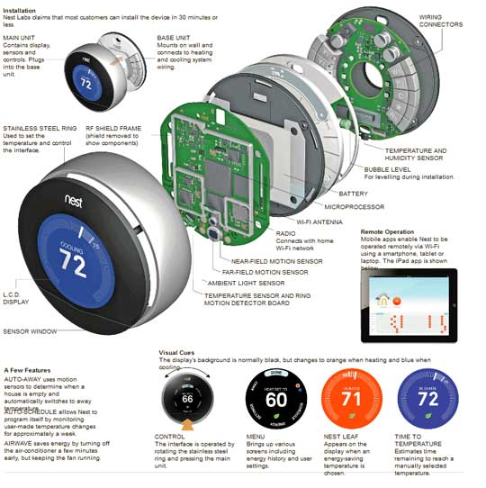
Nest Learning Thermostat

Slide 23
Sensitivity Analysis
Notes:
----- Meeting Notes (12/3/12 09:47) -----
Cost of User Time:
-assume user makes 75K/yr; workyear 2080 hrs
-roughly $36/hr
-assume user spends five min weekly programming a simple programmable thermostat (4 hrs/year)
-Nest automatically does this saving user money based on their value of time

Slide 24
Sensitivity Analysis
Net Present Value of Purchase

Slide 25






If you don’t trust us, ask them!

Slide 26
http://gigaom.com/cleantech/nest-makes-its-smart-thermostat-er-smarter/
http://bits.blogs.nytimes.com/2012/10/02/nest-second-generation/
http://www.energystar.gov/ia/partners/prod_development/revisions/downloads/thermostats/Summary.pdf
http://downloads.nest.com/summer_2012_savings_white_paper.pdf

Slide 27
